Slide 1
Sprint 7 Demo
Tuesday, July 26th , 2022

Slide 2
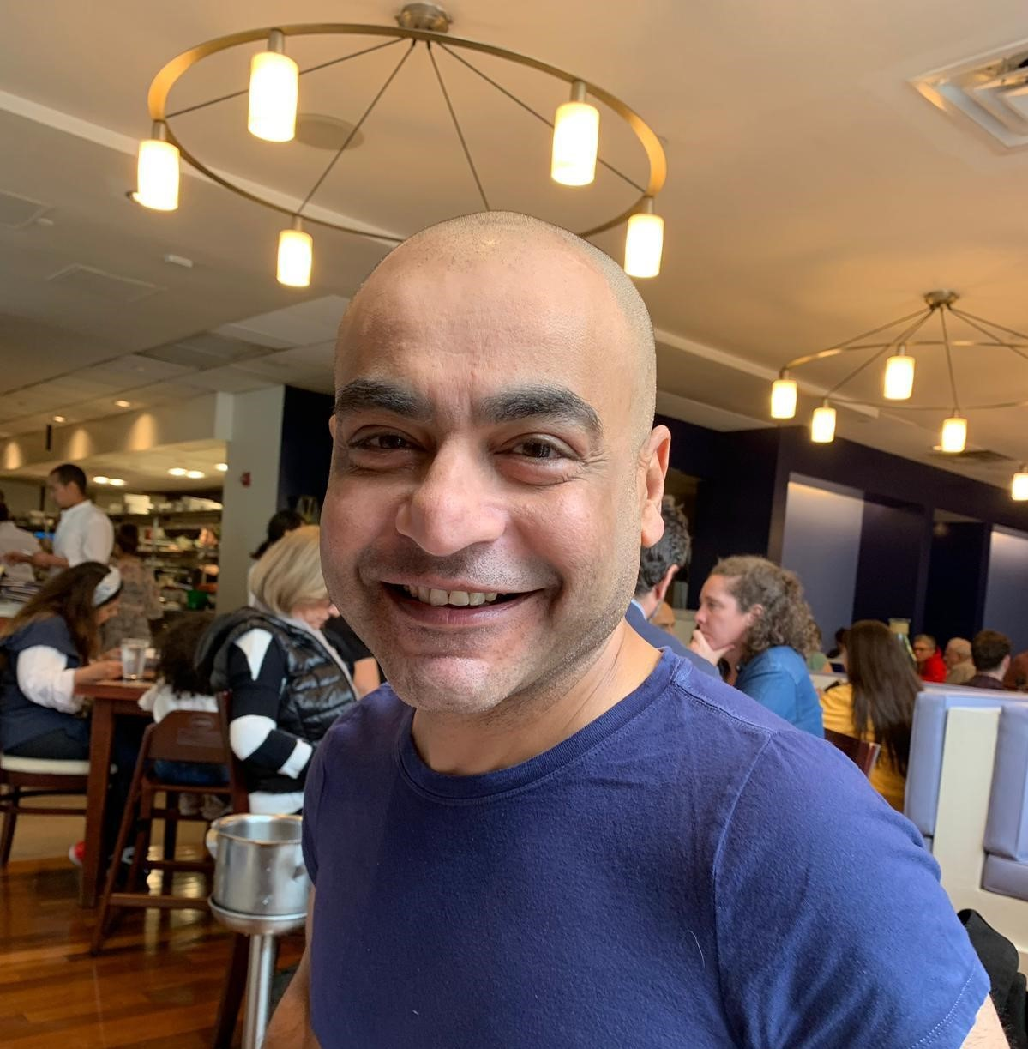
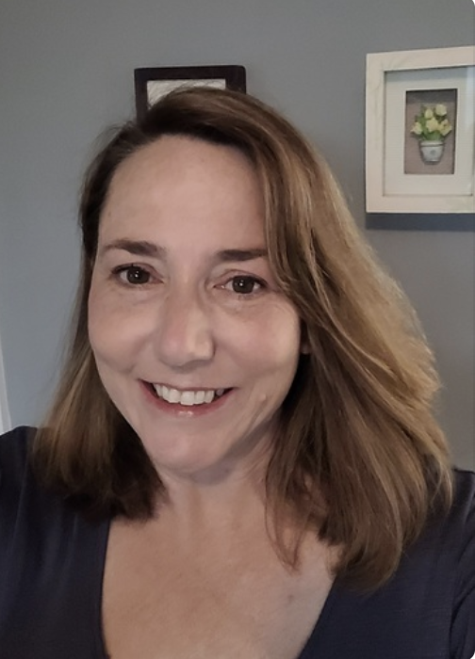

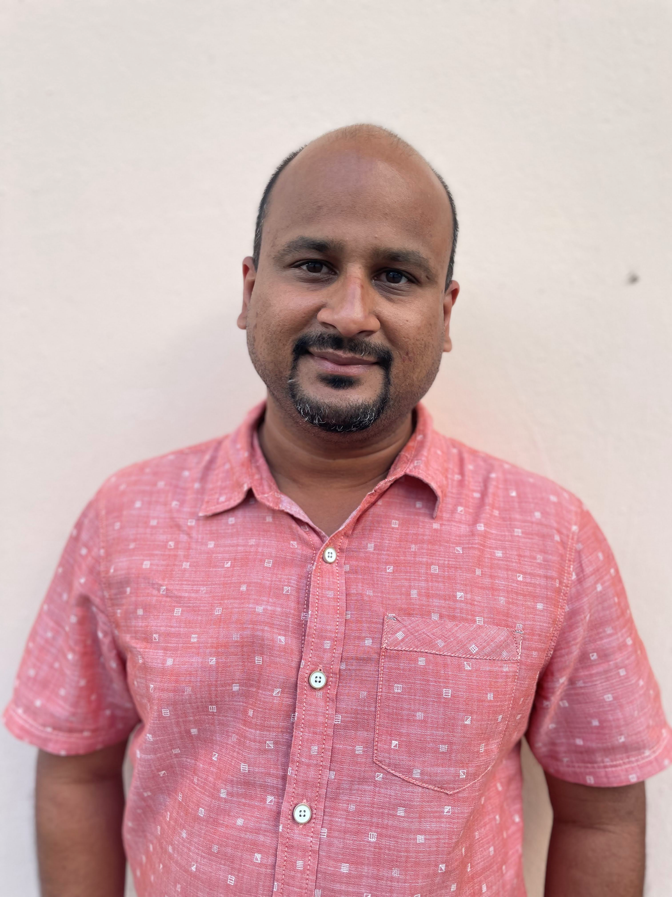










Get to know the team
Core team
Executive team
PRODUCT
ENGINEERING
Munish Sikka
Washington DC
Product Lead
Tami Corson
North Carolina
Clinical SME / Scrum
Dan Smith
Charleston, SC
QA Engineer / 508 Specialist
Shashank Khandelwal
Rockville, MD
Tech Lead
Jeff Scheire
MO Studio
Marcy Jacobs
McKinsey & Co
Kevin London Frog Design
DESIGN
Teagan Stephenson
Ft. Lauderdale, FL
Full Stack Engineer
1095-B Product Only
Thomas McCue Oak Park, IL Principal Designer Director
Carl Dickerson Atlanta, GA Content Strategist and Plain Language Content Creator
Carolyn Williams Chicago, IL Experience Designer
Will Reynolds SERVE Advisory
Ben Morris
Pluribus Digital
Jeanette Cantrell
MO Studio
07-26 Sprint 7 Demo
Introduction

Slide 3



At the end of each sprint on Tuesdays, the team will run sprint reviews to showcase the sprint’s work for approval. The purpose of this meeting is:
WELCOME TO THE SPRINT 7 DEMO
1
To demo the accomplishments or functionality that was built over the past sprint
2
To get feedback and insights early and often
3
To create transparency for anyone interested on the product and progress
07-26 Sprint 7 Demo
Introduction

Slide 4
CEDAR TO1 Overview
WE ARE HERE
CY 2021
CY 2022
PHASE
SPRINT
0
1
2
3
4
5
6
7
8
9
10
11
12
13
14
15
16
17
18
19
20
21
22
23
24
25
MONTH
Sep
Oct
Nov
Dec
Jan
Feb
Mar
Apr
May
Jun
Jul
Aug
Sep
DHM - Health Apartment
FOCUS
1095-B Form
Opt-in
Community Care
Health Hub
07-26 Sprint 7 Demo
Introduction

Slide 5
Agenda
Sprint Goal:
For sprint 7 we focused on refining research IA tree test synthesis, creating mobile designs of 1095-B, building the react widget for accessible MVP, and initiating collaboration toward getting our product into staging.
HEALTH HUB
Research synthesis
1095-B
Mobile designs
Build hybrid react widget
Collaboration cycle: Contact center review
 | We welcome all feedback! Feedback will be collectively reviewed and prioritized appropriately based on where it stacks against other stories in the backlog as well as technical feasibility.
07-26 Sprint 7 Demo
Agenda

Slide 6
Health Hub
SPRINT 7 DEMO
07-26 Sprint 7 Demo

Slide 7



Health Hub Workplan v7
Owned by design team
Owned by product team
WE ARE HERE
SPRINT 1
4/20 – 5/03
SPRINT 2
5/04 – 5/17
SPRINT 3
5/18 – 5/31
SPRINT 4
6/01 – 6 /14
SPRINT 5
6/15 – 6/28
SPRINT 6
6/29 – 7/12
SPRINT 7
7/13 – 7/26
SPRINT 8
7/27 – 8/09
SPRINT 9
8/10 – 8/23
SPRINT 10
8/24 – 9/6
Kickoff
Discovery
Build Roadmap
Product & Delivery
Build initial workplan and backlog
Business partner discovery
Moderated IA treejack Research
User Experience & Design
Comparative research
Consolidate existing research
Experience Map
Prototyping
Potential Second Prototype Research
Current state mapping
Research Activities Plan (RAP)
Final Recommended Prototype
IA Tree Test Plan H0 & H1
Final IA Recommendations delivered
Engineering & Development
Tech Discovery
Tech Feasibility
07-26 Sprint 7 Demo
Workplan

Slide 8
A
Research synthesis
User Story: Prep for review of research #1 with VFS-IA specialist
Key findings
Compared to Baseline, H0 had ≥10% better direct success on 6 of the 11 tasks*.
Compared to Baseline, H1 had ≥10% better direct success on 4 of the 11 tasks*.
Comparing H0 and H1, H0 had ≥10% better direct success on 7 of 11 tasks*.
For Veterans without health care, H0 had ≥10% better direct success on 7 of the 11* tasks, both when comparing to Baseline and H1.
For caregivers and family members, H0 had ≥10% better direct success on 6 of the 10** tasks when compared to H1.
For Veterans, the highest performing tasks were task 8 (bill pay) for Hypothesis 0 and task 9 (prescriptions) for Hypothesis 1.
For Veterans, the lowest performing tasks, with high directness were task X (H0) and task X (H1).
Deck
07-26 Sprint 7 Demo
Health Hub
8
Notes:
Carolyn

Slide 9
1095-B
SPRINT 7 DEMO
07-26 Sprint 7 Demo

Slide 10

1095-B Workplan v7
Owned by design team
Owned by product/ engineering team
Release
WE ARE HERE
SPRINT 7
4/20 – 5/03
SPRINT 8
5/04 – 5/17
SPRINT 9
5/18 – 5/31
SPRINT 10
6/01 – 6 /14
SPRINT 11
6/15 – 6/28
SPRINT 13
6/29 – 7/12
SPRINT 14
7/13 – 7/26
SPRINT 15
7/27 – 8/09
SPRINT 16
8/10 – 8/23
SPRINT 17
8/24 – 9/6
1095-B: Spanish translation docs
Turnover document of remaining post-MVP work (VA notify, 2022 IRS form, 508 compliance, multiple year selection)
1095-B: Legal Review
1095-B: Legal Review – Opt-in
Product & Delivery
VA 508 Assistance request
MVP 508 Spanish translation docs
Kickoff
Align on launch MVP v. MVP w/ opt-in
Draft opt-in legal review package
User Experience & Design
Design for opt-in
Launch communication plan
Notification flow
Design for MVP 508 accessibility
1095-B Wayfinding
Build for accessible MVP
Tech feasibility wayfinding
Engineering & Development
Tech feasibility opt-in build
UAT
Build for wayfinding
Build Analytics for launch monitoring
Collaboration Cycle
Call center review
Analytics & QA
Staging review – MVP
1095-B Post launch evaluation
Sitewide and Content IA ticket opt-in
Security & privacy review
MVP Launch
07-12 Sprint 6 Demo
Workplan

Slide 11
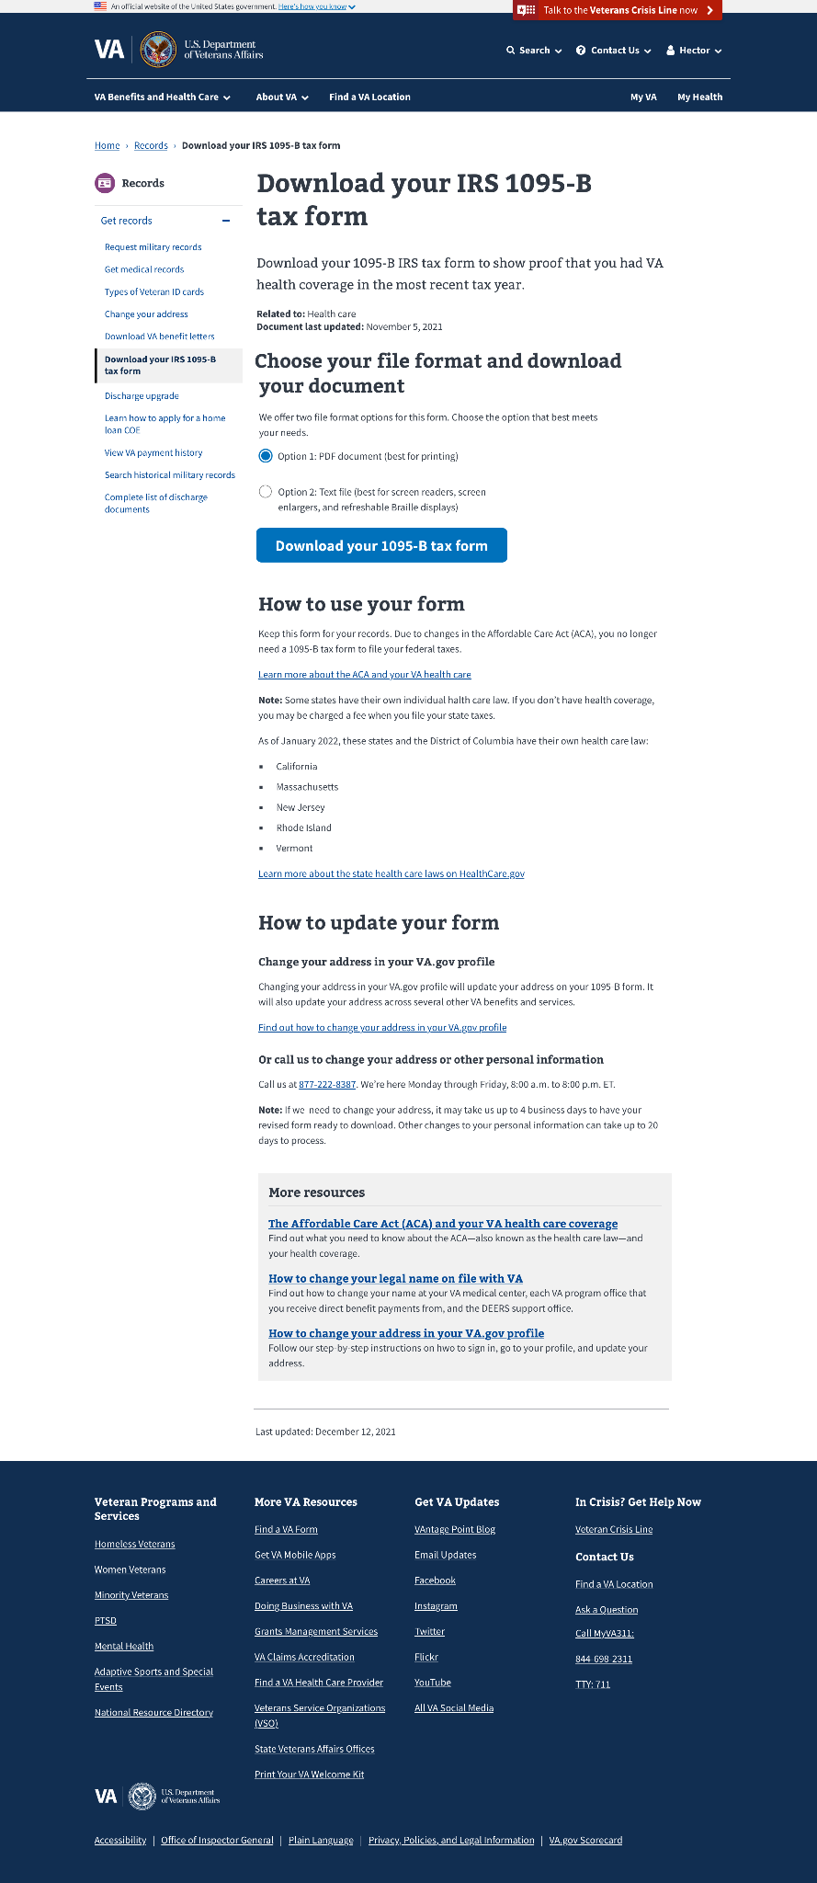
A
Mobile
User Story: Version hybrid design for mobile
Design update: Mobile screens for “hybrid” form download page
Screens for mobile for both MVP and Opt-in Hybrid model complete
Mobile auth / unauth design
07-26 Sprint 7 Demo
1095-B
11
Notes:
Thomas

Slide 12
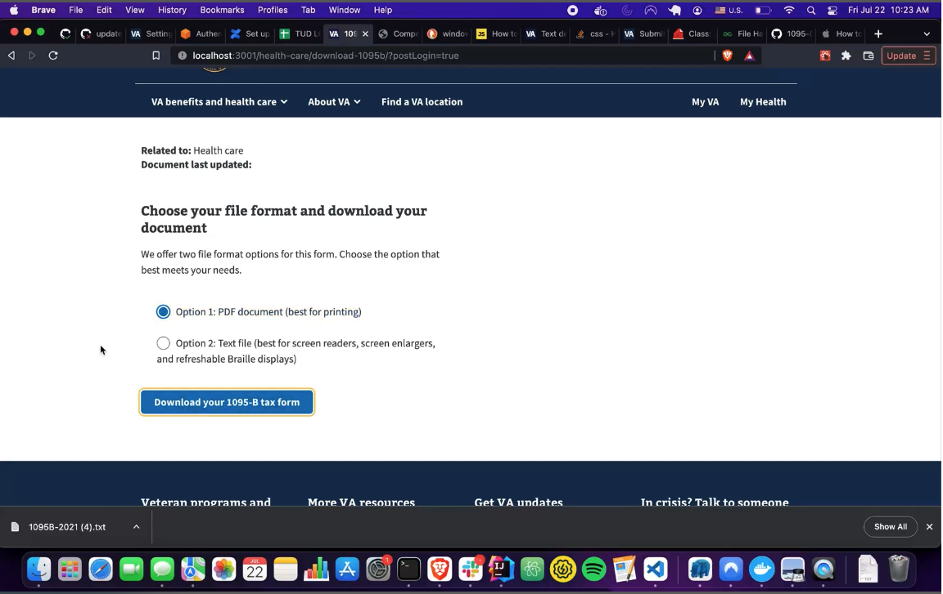
B
Build
User Story: Ensure text version of 1095-B passes accessibility test
User Story: Backend: Build 1095-B text version
User Story: Build 1095-B frontend with Text / PDF download options
User Story: QA frontend content on build
User Story: Write backend API test
PDF and text version development is complete.
We’ll now go through testing, documentation, and other reviews for release.
Jaws test, GitHub branch FE / BE, Widget demo video
07-26 Sprint 7 Demo
1095-B
12
Notes:
Shashank

Slide 13
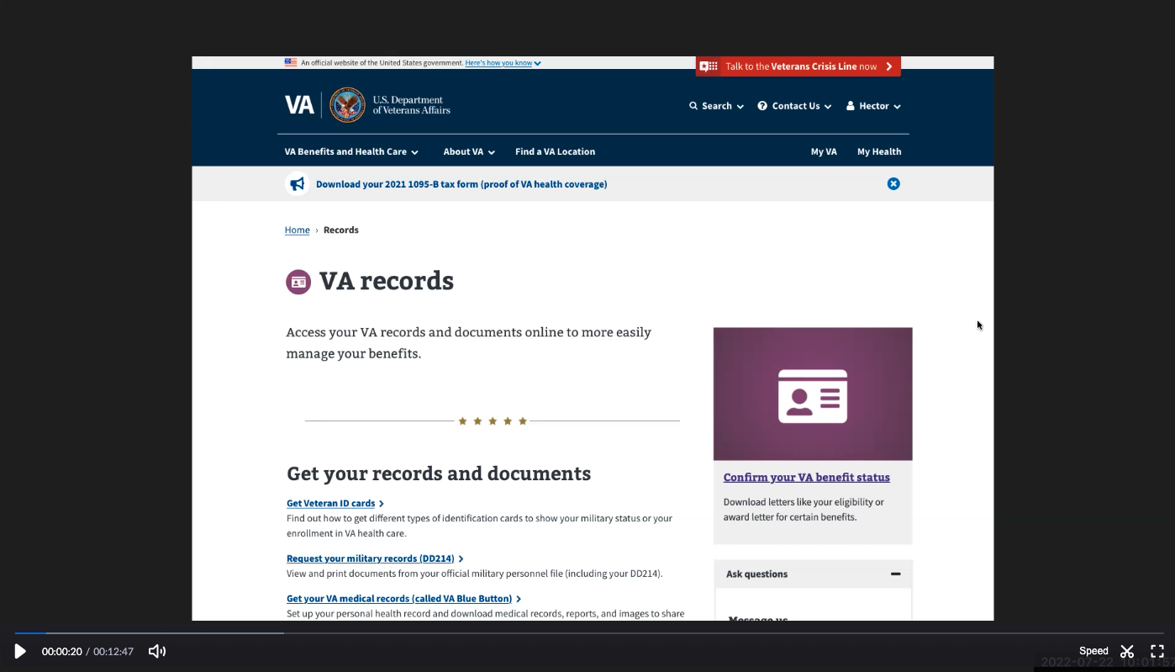
C
Collaboration cycle: Contact Center Review
User Story: Build design prototype of hybrid MVP for demonstration
User Story: Finalize call center documents and video with new designs for anticipation of contact center review
User Story: Collaboration cycle: Contact center review
Product Guide for Contact Center Review has been revised and finalized
Incorporates updated content for new hybrid design
Prepared for translation & shared with business partners
Prepared additional iterations for Post MVP opt-in functionality
New Product Video has been recorded and submitted
Recorded using prototype that highlights new hybrid design
Transcript of video created & uploaded
Prototype, product guide, product video, video transcript
07-26 Sprint 7 Demo
1095-B
13
Notes:
Carl

Slide 14
Blockers for 1095-B launch
BLOCKER | OWNED BY | ACTION NEEDED | DATE ENTERED | STATUS | NOTES
Legal Review Opt-in | Tarsha Tremble (Business Owner) | Business Owner is seeking a POC with the Office of General Counsel to understand requirements for legal review and timeline | Sprint 3 - 3/2/22 |  | MVP is approved, opt-in is still pending review
PDF Accessibility | Tarsha Tremble (Business Owner) | Team received PDF from IRS, but PDF is still not accessible once it is populated with data | Sprint 3 – 3/3/22 |  | Resolved, IRS txt version is acceptable format, passed internal 508 check 7/15
Translation Original MVP | Tarsha Tremble (Business Owner) | Follow up with translation progress of MVP materials | Sprint 7 – 4/20/22 |  | Resolved, no longer required r/t design change 7/12
Alignment Opt-in | Team | Meetings with VA Profile Frontend & Backend, VANotify | Sprint 14 – 7/19/22 |  | Opt-in flow for profile changes and notification flow is one meeting away from resolution
07-26 Sprint 7 Demo
1095-B Blockers

Slide 15
1095-B Remaining actions, with external dependencies
ITEM | WORK STREAM | ACTION NEEDED | TARGET COMPLETE DATE | PREREQUISITE
Launch | Product & Tech | Work with tech to create a vets-website release | Aug | Hybrid MVP build for accessibility
UAT | Product & Tech | Follow Collaboration Cycle guidelines for UAT Identify Veterans within VA to conduct UAT, send access, and follow up to ensure testing complete | Aug | MVP dark launch
1095-B Opt-in | Product | Follow up with HEC and Profiles team to ensure 1095-B opt-in is done Follow up with Notifications team to ensure related SMS & e-mail notification flow is optimal Internal testing of text version of 1095-B Update draft communications and announcement plans, based on when opt-in will be launched | Oct | Ongoing collaboration meetings to align responsibilities and timeline
Notification Triggers | Design & Tech | Notification letters approved by legal Build triggers for opt-in, opt-out, annual update | Sep / Oct | Legal review
Legal Review | Product | Work with Tarsha to complete legal review for Opt-In | Oct / Nov | POC name from Tarsha. Legal package submitted by team and VA profile
Post MVP Launch Check- In | Product | Complete Collaboration Cycle milestone to KPIs post launch | TBD (One month after launch and announcement) | Product launched in prod
Links from VA.gov pages to 1095-B (wayfinding) | Product & Design | Work with IA team to have other identified pages within VA.gov (e.g., ACA page) link to the 1095-B page Work with IA team to have 1095-B page added to navigation and be found in VA.gov search | Aug / Sep | Product launched in prod; aligned on comm plan with Tarsha, Tracey
1095-B update strategy | Product | Align on who will own 1095-B long term, including updating the PDF template each year | Sept | Product complete and launched in production
Communications to announce launch | Product & Design | Work with Tarsha and HEC team to refine drafted communications and align on plan and timeline to announce 1095-B launch to Veterans Work with VA Notify team to build and launch communications on their platform | Aug | Product launched in prod; aligned on communication plan with Tarsha/Tracey
07-26 Sprint 7 Demo
1095-B Remaining actions

Slide 16
Sprint Deliverables
SPRINT 7 DEMO
07-26 Sprint 7 Demo

Slide 17
Sprint 7 Deliverables Health Hub
EPIC | STORY | ESTIMATE | ASSIGNED | OUTPUT | REVIEWED W/ VA-PO | SPRINT TEAM GOAL COMPLETED?
Research | #44325 Prep for review of research #1 with VFS-IA [Mikki] | 2 | Carolyn Shashank | Design review deck Feedback | 7/21/2022 | ✓
Research | #44323 Finalize research plan #2 – Moderated testing of trees | 5 | Carolyn | Research plan #2 | 7/26/2022 | ✓
Research | #44324 Finalize conversation guide for research plan #2 – moderated testing of trees | 3 | Carl | Conversation guide | 7/26/2022 | ✓
07-26 Sprint 7 Demo
Sprint 7 Deliverables

Slide 18
Sprint 7 Deliverables 1095-B
EPIC | STORY | ESTIMATE | ASSIGNED | OUTPUT | REVIEWED W/ VA-PO | SPRINT TEAM GOAL COMPLETED?
Design | #44274 Version hybrid design for mobile | 2 | Thomas Carl | Mobile MVP auth Mobile MVP unauth | 7/21/2022 | ✓
Design | #44273 Build design prototype of hybrid MVP for demonstration | 2 | Thomas Carl | Prototype | 7/21/2022 | ✓
Content | #39516 Finalize HEC documents for translation w/ hybrid designs and content | 3 | Carl | User guide FAQ’s Cover letter Fact sheet | 7/26/2022 | ✓
Accessible | #43653 Ensure text version of 1095-B passes accessibility test | 5 | Teagan Shashank Tami | Screen read txt ver | 7/12/2022 | ✓
Tech | #44288 Backend: Build 1095-B Text version | 8 | Teagan Shashank | Demonstration video GitHub branch - BE | 7/26/2022 | ✓
Tech | #43596 Build 1095-B front end with Test/PDF download options | 5 | Teagan Shashank | Demonstration video GitHub branch - FE | 7/26/2022 | ✓
Content | #44602 QA front end content on build | 1 | Carl | NR | 7/12/2022 | ✓
Collab | #44263 Collaboration cycle: Kickoff | 2 | Tami | GitHub ticket #44401 Updated product outline Approved designs | 7/14/2022 | ✓
Collab | #44576 Discovery on design review requirements for collaboration cycle | 1 | Tami | DSVA Slack | 7/19/2022 | ✓
Tech | #44271 Meet w/ Analytics team | 1 | Munish Shashank | DSVA Slack | 7/19/2022 | ✓
07-26 Sprint 7 Demo
Sprint 7 Deliverables

Slide 19
Sprint 7 Deliverables 1095-B
EPIC | STORY | ESTIMATE | ASSIGNED | OUTPUT | REVIEWED W/ VA-PO | SPRINT TEAM GOAL COMPLETED?
Content | #44266 Finalize call center documents and video with new designs for anticipation of contact center review | 5 | Carl | Product guide - MVP Product video - MVP Product video transcript - MVP | 7/26/2022 | ✓
Collab | #44593 Collaboration cycle: Contact center review [MOVE – 1095-B hybrid MVP for accessibility] | 1 | Carl | Ticket | 7/26/2022 | ✓
Opt-in | #43821 1095-B engineering document “How it works” | 5 | Shashank | 1095-B MVP document | 7/20/2022 | ✓
Opt-in | #44293 Align on opt-in build with VA Profile BE/FE and VA Notify teams | 3 | Munish Tami Shashank | 6/17 Zoom video 6/23 Zoom video 7/19 Zoom video | 7/20/2022 | ✓
Tech | #44657 Write backend API tests | 3 | Teagan | NR | 7/26/2022 | ✓
07-26 Sprint 7 Demo
Sprint 7 Deliverables

Slide 20
Preview of Sprint 8
SPRINT 7 DEMO
07-26 Sprint 7 Demo

Slide 21
Sprint 8 will focus on
 | Next sprint demo: Aug 9th
HEALTH HUB
*Stories subject to change during sprint planning
Moderated research recruitment
Research pilot testing
1095-B
Collaboration cycle: Privacy and security review
Collaboration cycle: Analytics implementation and QA
Post-MVP Opt-in coordination / alignment plan
Staging 508 compliance review
07-26 Sprint 7 Demo
Preview of Sprint 8

Slide 22
Appendix
SPRINT 7 DEMO
07-26 Sprint 7 Demo

Slide 23
Project risks and mitigation strategies (1 of 2)
RISK AND IMPACT | MITIGATION STRATEGY | DATE |  | STATUS | NOTES
 |  | ENTERED | CLOSED
IRS stakeholder is outside of VA ecosystem. Building without guidance or legal review regarding compliance with IRS regulation could result in risk. | Conduct research on available information surrounding current IRS 1095-B tax form regulations. Seek legal review through VA resources as directed by VA-PO and Business Owner | 1/20/22 | 2/11/22 |  | VA Business Owner clarified that IRS review is not needed
Team had previously confirmed with Business Owner that legal review was not needed. Business Owner clarified that legal review would be needed as of March 2nd | Business Owner is seeking a POC with the Office of General Counsel to understand what is needed and potential launch impact | 3/2/22 | 5/17/22 |  | Launch blocker
Data requires storage in a S3 bucket that the enrollment system can have access to in production; process to create the staging and production bucket does not have a clear timeline. Without the S3 bucket in prod with enrollment system access, product cannot be built in prod | Daily follow-ups with Jesse House and Mike Chelan (infrastructure team) | 3/1/22 | 3/24/22 |  | S3 bucket now in place. Risk resolved.
Business owner raised User Acceptance Testing should be done with HEC Call Center | Requested Business Owner to schedule UAT with required individuals for mid-March and book as early as possible | 3/2/22 | 3/25/22 |  | Business owner confirmed that UAT can be done through Collaboration Cycle and does not have to be done with HEC team
Feedback from Content and IA Review has taken over a week to come in; feedback is changing our proposal for the H1 and delaying confirmation of where the 1095-B landing page should live, which in turn delays our ability to complete the front end (top nav and side nav bars) | Design team pushing on IA team to confirm final answer of where 1095-B landing page should live and what the H1 header title should be | 03/04/22 | 3/8/22 |  | URL confirmed 3/7 EOD; IA review now closed

Slide 24
Project risks and mitigation strategies (2 of 2)
RISK AND IMPACT | MITIGATION STRATEGY | DATE |  | STATUS | NOTES
 |  | ENTERED | CLOSED
Designs were approved as part of Midpoint Review. Afterwards, Sitewide Content stated they would need to build our front end in Drupal and change our designs, impacting our in-flight build. | Design team met with Sitewide Content to align on redesigned front end. Tech working with Sitewide Content to send over our dynamic widget to be pulled into their static front end. Sitewide Content now owns the front end build. | 3/10/22 |  |  | Launch date dependent on Sitewide Content ability to launch front end
HH Tree Test design held up due to new information from Meg, Danielle and Mikki. | VA and MO team could work in collaborative sessions so that work is not duplicated, and we can arrive at a test design that works by the end of Sprint 3 | 5/16/22 | 5/26/22 |  | Awaiting version of ‘manage’ tree that we can incorporate into research trees in order to move forward with research plan
HEC Legal review required for 1095-B Opt-in | Opt-in is being built by VA Profile team | 3/2/22 |  |  | Post-MVP enhancement blocker
07-26 Sprint 7 Demo

Slide 25
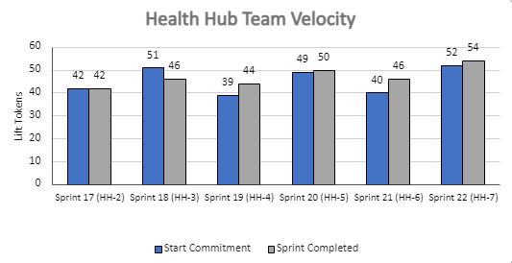
Health Hub Team velocity
 | Velocity details Velocity estimated in story points, using Fibonacci Velocity in Sprint 7 accounted for 7 team members 54 total story points were completed; Team committed to 52 story points at beginning of the sprint. 3 Stories added (2 points) to account for added collaboration cycle: contact center review and work pulled forward due to early build; QA for front end content and build back end API tests. 1 story blocked (3 points) pending collaborative action plan w/ VA Profile FE/BE and VA Notify for opt-in build
07-26 Sprint 7 Demo
Appendix
25

Slide 27
A
Lorem
User Story: Lorem
User Story: Lorem
User Story: Lorem
User Story: Lorem
User Story: Lorem
Lorem
Lorem
Lorem
Lorem
Lorem
Lorem
Lorem
Link
07-12 Sprint 6 Demo
Lorem
27

Slide 28
A
Lorem
User Story: Lorem
User Story: Lorem
User Story: Lorem
User Story: Lorem
User Story: Lorem
Lorem
Lorem
Lorem
Lorem
Lorem
Lorem
Lorem
Link
07-12 Sprint 6 Demo
Lorem
28

Slide 29
A
Lorem
User Story: Lorem
User Story: Lorem
User Story: Lorem
User Story: Lorem
User Story: Lorem
Lorem
Lorem
Lorem
Lorem
Lorem
Lorem
Lorem
Link
07-12 Sprint 6 Demo
Lorem
29

Slide 30
Sprint __ Deliverables – __
EPIC | STORY | ESTIMATE | ASSIGNED | OUTPUT | REVIEWED W/ VA-PO | SPRINT TEAM GOAL COMPLETED?
R | #40000 Lorem | 0 | C | Lorem Lorem Lorem Lorem Lorem | 7/12/2022 | ✓
R | #40000 Lorem | 0 | C | Lorem Lorem Lorem Lorem Lorem | 7/12/2022 | ✓
R | #40000 Lorem | 0 | C | Lorem Lorem Lorem Lorem Lorem | 7/12/2022 | ✓
R | #40000 Lorem | 0 | C | Lorem Lorem Lorem Lorem Lorem | 7/12/2022 | ✓
R | #40000 Lorem | 0 | C | Lorem Lorem Lorem Lorem Lorem | 7/12/2022 | ✓
R | #40000 Lorem | 0 | C | Lorem Lorem Lorem Lorem Lorem | 7/12/2022 | ✓
R | #40000 Lorem | 0 | C | Lorem Lorem Lorem Lorem Lorem | 7/12/2022 | ✓
R | #40000 Lorem | 0 | C | Lorem Lorem Lorem Lorem Lorem | 7/12/2022 | ✓
R | #40000 Lorem | 0 | C | Lorem Lorem Lorem Lorem Lorem | 7/12/2022 | ✓
R | #40000 Lorem | 0 | C | Lorem Lorem Lorem Lorem Lorem | 7/12/2022 | ✓
07-12 Sprint 6 Demo
Sprint 5 Deliverables

Slide 31
Sprint 1 will run April 20 to May 3rd
Owned by design team
Owned by product/ engineering team
Release
WE ARE HERE
SPRINT 1
SPRINT 2
SPRINT 3
SPRINT 4
SPRINT 5
Week 1: 04/20 – 04/26
Week 2: 04/27 – 05/03
Week 3: 05/04 – 05/10
Week 4: 05/11- 05/17
Week 5: 05/18 – 05/24
Week 6: 05/25 – 05/31
Week 7: 06/01 – 06/07
Week 8:
06/08 – 06/14
Week 9: 06/15-06/21
Week 10: 06/22-06/28
Product & Delivery
1095-B: Identify Change Management or Communications Plan
1095-B: Legal Review
1095-B: Handover plan - Prepare for launch
1095-B: Opt-in follow up
1095-B: Spanish translation docs
HH: Charter
HH: Develop backlog + Vision Framework
HH: Roadmap
User Experience & Design
1095-B: Wayfinding plan
Testing prep & recruiting
Voice of Veteran
Voice of Veteran
HH: Discovery
HH: Stakeholder Interviews
HH: Current State Journey Map
Prioritized plan
Engineering & Development
HH: Tech discovery
HH: Stakeholder Interviews
HH: Proposed tech integrations based off research findings
Collaboration Cycle
Midpoint Review
1095-B: Launch Date Dependent on Legal Review Completion
Research Plan Review
Research Plan Review
*Does not show post-MVP Validate phase meetings in Collaboration Cycle, such as Full Accessibility Audit and Post-Launch Check In; Contact Center Review adjusted to 3 weeks before launch as approved by Jason Woodman
Preview of Sprint 7

